Slide 1

Domain Specific Languages The functional Way
Tomas Petricek @tomaspetricek | www.fsharpworks.com

Slide 2
software stacks trainings teaching F# user groups snippets mac and linux community books and tutorials
F# Software Foundation
consulting open-source MonoDevelop
http://www.fsharp.org
contributions research support cross-platform mailing lists

Slide 3
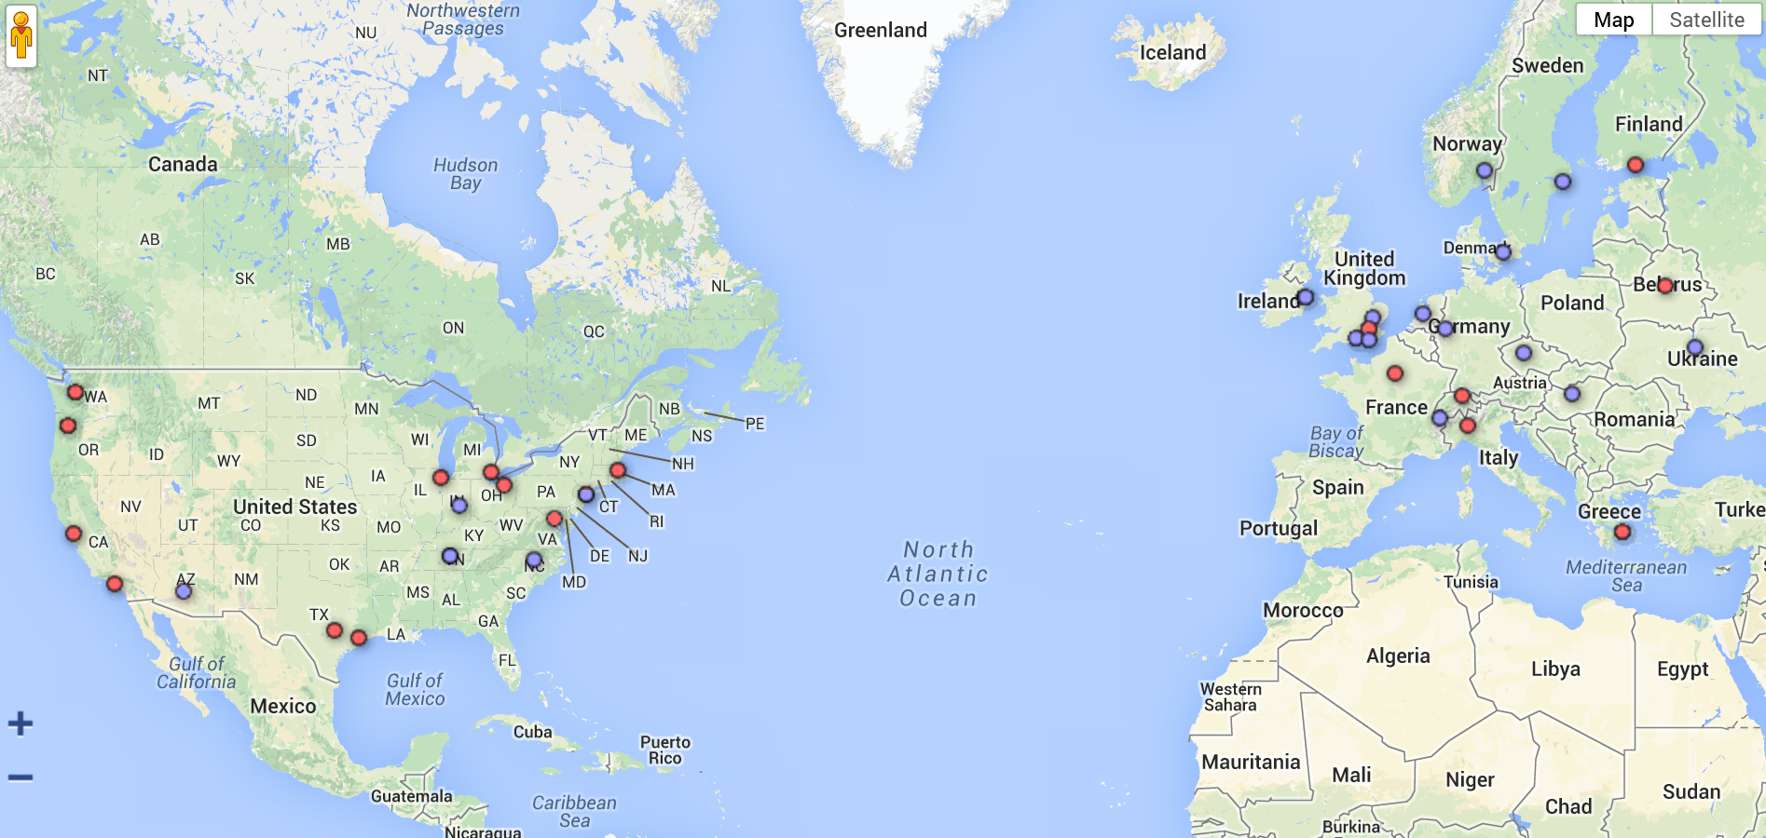


Slide 4
Time to Market
Kaggle
Interactivity
Machine learning
GameSys
Data processing
Social Gaming
Concurrency
Tachyus
Analysis & reporting
Time to market
Credit Suisse
Complexity
DSLs
Oil & gas startup
Financial models

Slide 5
DSL
= model + syntax

Slide 6
Composing 3d objects

Slide 7
Domain-specific language approach
Class of problems
Constructing 3D objects
Makefiles, stock price modelling, testing, …
Domain-specific language in F#
Primitives – basic building blocks
Composition – how to put them together

Slide 8
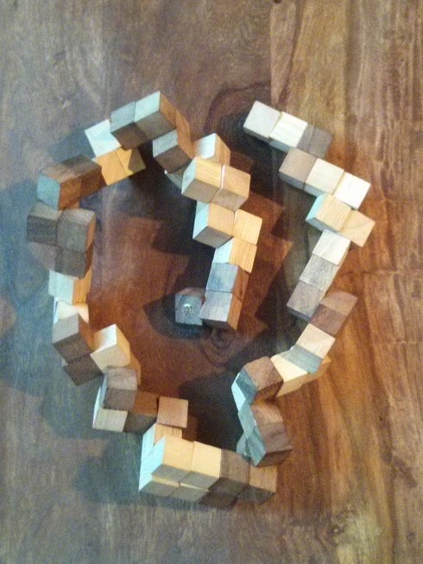
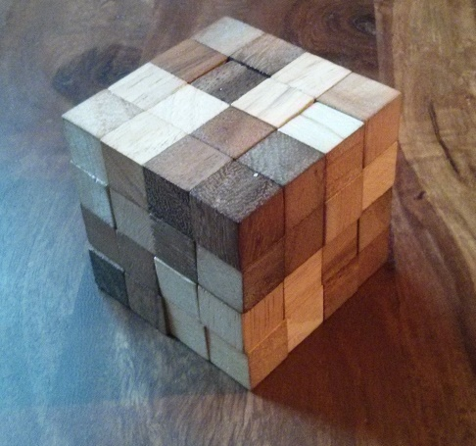
http://tomasp.net/blog/2014/puzzling-fsharp/

Slide 9
Generating text documents

Slide 10
Domain model & Processing
What is a text document?
How can we process it?

Slide 11
Building an F# DSL

Slide 12
Operations on documents
Parse Read from Markdown format
Format Generate HTML output
Process Translate to Norwegian!

Slide 13
Processing documents

Slide 14
DSL for writing documents
Creating DSLs with F# =====================
Key components of a DSL:
* **Model** describes the
structure of the domain
that we are modelling
* **Syntax** provides an easy
way for solving problems
using the DSL
Creating DSLs with F#
Key components of a DSL:
Model describes the structure of the domain that we are modelling
Syntax provides an easy way for solving problems using the DSL

Slide 15
Parsing markdown
http://manning.com/petricek2

Slide 16
Processing Markdown
Domain model
Understand the problem domain!
Using F# discriminated unions
Domain-specific language
Internal – just an F# library!
External – parsing Markdown is easy!

Slide 17
Detecting price patterns

Slide 18
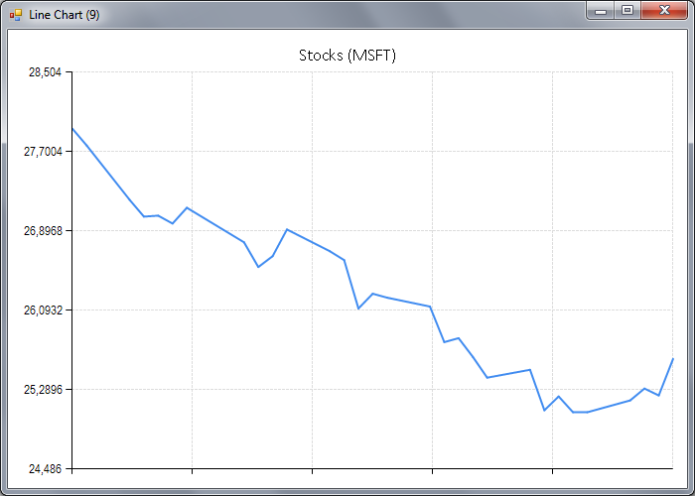
Declining pattern

Slide 19
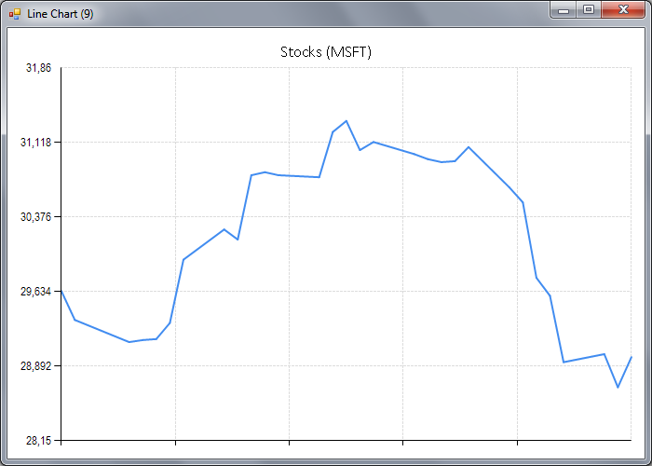
Rounding top pattern

Slide 20
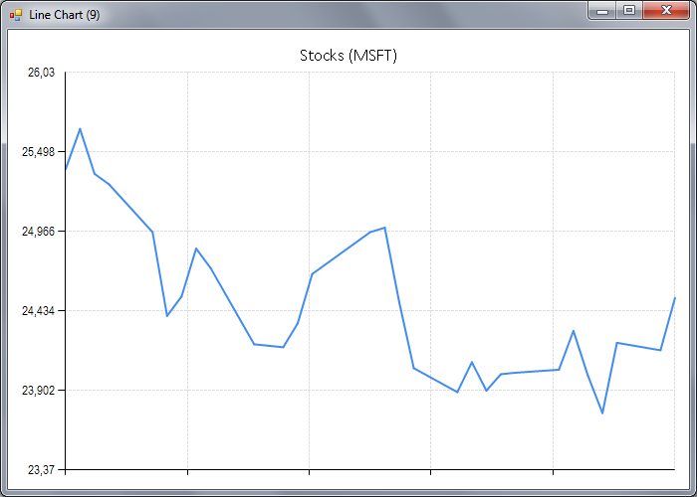
Multiple bottom pattern

Slide 21
Functional DSL style
Primitive classifiers
Declining price
Rising price
Composing classifiers
Sequence and parallel patterns
Linear regression

Slide 22
Detecting price patterns

Slide 23
Summary

Slide 24
❶ Understand problem domain Primitives & Combinators
❷ Model the language using Discriminated Unions
❸ Add convenient Syntax Internal or External
tomas@tomasp.net | @tomaspetricek | http://fsharpworks.com

